Slide 1
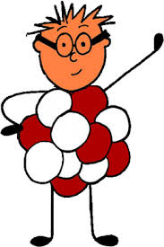
What’s the Matter?
Integrating opinion writing and structures and properties of matter
Nikki Hunt
RSPDI Team-Kentucky Writing Project Network

Slide 2
CCSS & NGSS
W.2.1
Write opinion pieces in which they introduce the topic or book they are writing about, state an opinion, supply reasons that support the opinion, use linking words (e.g., because, and, also) to connect opinion and reasons, and provide a concluding statement or section.
SL.2.1 Participate in collaborative conversations with diverse partners about grade 2 topics and texts with peers and adults in small and larger groups.
SL.2.1.a Follow agreed-upon rules for discussions (e.g., gaining the floor in respectful ways, listening to others with care, speaking one at a time about the topics and texts under discussion).
SL.2.1.b Build on others' talk in conversations by linking their comments to the remarks of others.
SL.2.1.c Ask for clarification and further explanation as needed about the topics and texts under discussion.
2-PS1-4
Construct an argument with evidence that some changes caused by heating or cooling can be reversed and some cannot. [Clarification Statement: Examples of reversible changes could include materials such as water and butter at different temperatures. Examples of irreversible changes could include cooking an egg, freezing a plant leaf, and heating paper.]

Slide 3
What are the lesson outcomes?
W.2.1
I know…
-how to introduce the topic I am writing about by stating a claim.
-how to provide evidence from sources.
-how to provide a concluding statement/section.
SL.2.1
I know…
-how to follow agreed-upon rules for discussion.
-build on others’ talk in conversations by linking their comments to remarks by others.
-seek further clarification/explanation.
2-PS1-4
I know…
-how to construct an argument with evidence that some changes caused by heating or cooling can be reversed and some cannot.
Notes:
Review outcomes with students at the onset of instruction. Address content and language purposes for the lesson.

Slide 4
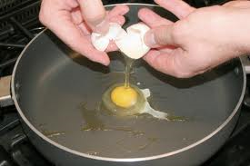
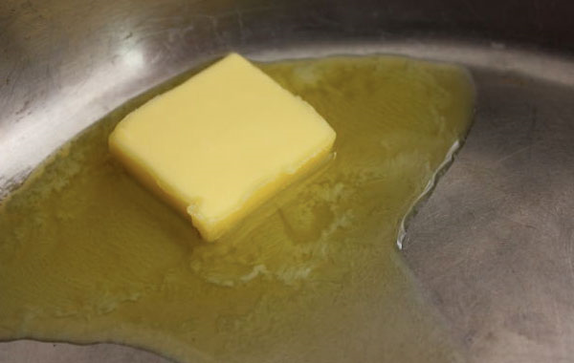
Pause, think, talk
Can heating and cooling cause substances (things) to change?
Can substances go back to the way they were before?
Notes:
Think, pair, share…allow students ample time to discuss

Slide 5
Share
What do you think?
Notes:
Chart responses…accept any and all

Slide 6
Your turn to write…
“First I thought…”
This is your hypothesis!
Notes:
Refer to “Opinion Writing Template”…have students complete, “First I thought…”

Slide 7
What do you think will happen? Let’s Predict!
Write your predictions on the “Investigate Organizer”.
Notes:
Refer to “Investigate Organizer”…Introduce each scenario and have students turn and talk about their predictions prior to writing. Give students time to complete all “prediction” sections. Afterward, begin experimenting. You can decide what you plan to do, and in what order. It will take a couple of days.

Slide 8
What did we observe (see or notice)?
What happened?
Turn and talk.
Add your findings to your organizer.
Notes:
Use this slide as you experiment with each substance (investigate organizer)

Slide 9
So…
Review your organizer.
Talk with your group members.
-What happened?
-Did the substance change? How?
-What caused the changes?
-What can you conclude?
-Add your conclusions to your organizer.
Notes:
Use this slide to have students discuss their findings as a result of observation…add conclusions to organizer

Slide 10
Let’s bring it all together!
Let’s look at our organizers. You’ve shared with your group members. Let’s have a whole class discussion.
-What happened during all experiments (water, egg, paper, butter)?
-Did the substances change? If so, how?
-What caused the changes?
-What can we conclude?
Notes:
You may wish to chart responses here

Slide 11
What have we learned?
Turn and talk.
Now, you write.
-Then, I learned…
Notes:
Add responses to “Opinion Writing Template”

Slide 12
What do the experts say?
https://www.youtube.com/watch?v=tHM0UkhwfsQ
Notes:
Video…you might encourage students to take notes on back of organizer

Slide 13
What have we learned from experts?
Turn and talk.
Now, you write.
-Then, I learned more…
Notes:
Add responses to “Opinion Writing Template”

Slide 14
How can we use what we’ve learned?
We learned that heating and cooling can cause substances to change.
We also learned that some substances can go back to the way they were before (reversible changes) and some cannot (irreversible changes).
What do we think will happen to other substances?
Write! Now, I think…
Notes:
Complete template and wrap up by reviewing what was learned

