Slide 1
Reading for Effective Arguments
Linda Denstaedt ldenstaedt@ameritech.net
CRWP Leadership Team Oakland Writing Project (MI)

Slide 2
Role of Reading in Writing Arguments
Texts Written by Others
OWN Writing
Become informed on an issue and form a claim
Collect and sort information to support a claim
Identify the complexities and multiple perspectives on an issue
Study and mentor decisions of effective arguments
Re-read to understand what I think and how my thinking is changing
Re-read to organize evidence and plan a draft
Re-read to analyze and rethink an early draft to plan revisions
Notes:
Reading plays an important role in writing arguments. Students read to 1] learn about issues; 2] gather information to form and support views; 3] Go deeper into an issue to understand the multiple perspectives and complexities; and 4] study and mentor the skills of effective argument writers. Students also read and re-read their own writing to 1] capture, track and revise thinking; 2] organize and plan a draft; 3] to rethink and revise a draft.

Slide 3
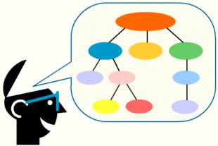
Reading Engages Complex and Multiple Processes
Notes:
First, did you clarify or change your claim? What evidence in this article added to your thinking and caused you to change your mind or clarify your first claim?
Second, reflect on the levels and ways you read. Re-read the roles reading plays in writing arguments. What roles did reading play in your thinking and writing about online privacy?
And re-read the descriptors of an interactive reader. What descriptors would describe you as a reader? How did those actions help you think, organize evidence, and form a claim?
How will this impact reading work and instruction in your classroom?

Slide 4
Reading is Thinking
Make connections and activate prior knowledge
Make inferences to connect information and draw conclusions
Generate questions to clarify and extend thinking
Determine important information
Learn and change thinking during reading
Notes:
Reading is thinking. Multiple things happen in a reader’s mind while reading. Often this thinking is invisible and private. CRWP teaches students strategies to make their thinking visible on the page of texts they read through annotating or coding a text; in graphic organizers that collect and organize information; and in their writer’s notebooks as they gather information, reflect, respond, and rethink along the way.

Slide 5
Strategies to Scaffold Complex Texts
Provide accessible texts that build in complexity
Modeling and thinking-aloud for students and with students
Peer conversations to rehearse thinking while reading
Multi-draft gradual release reading
Graphic organizers focused on a specific skill

Slide 6
Activate your prior knowledge & attitudes
At this point, what seems to be the most important information you already know about online privacy?
What conclusions can you draw about Amazon’s attitude toward my previous purchases?
How does that inference activate your prior knowledge?
Online Privacy
What do you think about your privacy when you are online?
What questions do you have?
Notes:
Let’s slow down the multiple levels of thinking that automatically. This we may not even be aware that it occurs.

Slide 7
Interactive Reader
Codes and Annotates
Makes Sense
Observes & takes notes on details, words, images
Evidence: facts, examples, quotes (authorities)
Important or compelling evidence
Claims & counterclaims
1. Prior knowledge and attitudes
2. Background information
3. What’s interesting but not important
4. Tracks key evidence and evidence sets
○ pro and con evidence
○ facts, authorities & countering
5. Commentary
○ What others think
○ What I think
Notes:
We want our students to be interactive readers who are aware of the multiple ways they think and make sense of information, ideas, and issues as they read.

Slide 8
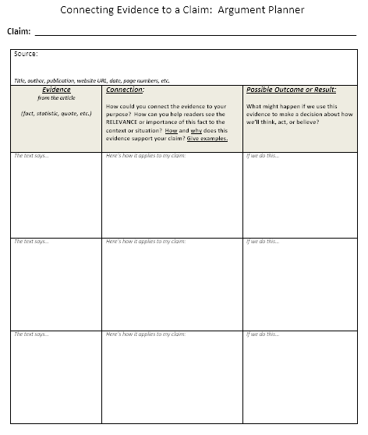
Graphic Organizers
Make Thinking Visible

Slide 9
Reading to Think & Draft
What do we want students to do and think as they read?
Connect, clarify and extend your knowledge
Underline statements that explain why there is a debate.
Identify the most important evidence. # Top 4.
Code
F Compelling Facts
E Important Examples
Write a key word or phrase to quickly identify each piece of evidence.
Draw conclusions identify important information

Slide 10
Rereading and Writing to Think
What Does the Evidence Suggest?
What Do you Think?
Write a claim that expresses your current view.

Slide 11
Reading to Go Deeper and Rethink
What do we want students to do and think as they read?
Connect, clarify and extend your knowledge
Underline statements that explain why there is a debate.
Identify the most important evidence. # Top 4.
Code
F Compelling Facts
E Important Examples
Draw conclusions identify important information

Slide 12
Rereading and Writing to Think
What Does the Evidence Suggest?
What Do you Think?
Write a claim that expresses your current view.

Slide 13
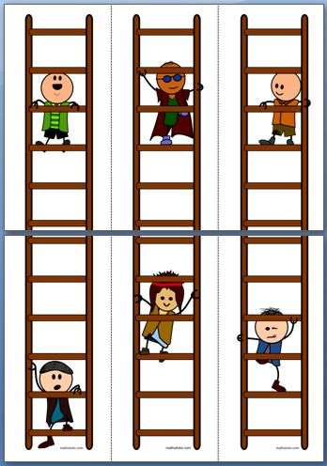

Slide 14
CRWP’s Focus Develop Argument Skills Across Time
Entering Skills
FOUNDATIONAL SKILLS
Going Deeper Skills
Annotating text
Drafting a claim
Identifying evidence (quotations, facts, & statistics) to support the claim
Tying evidence to the
claim
Explaining its
relevance
Authorizing
Countering

Slide 15
CRWP’s Focus Develop Argument Skills Across Time
Entering Skills
FOUNDATIONAL SKILLS
Going Deeper Skills
Ability to draft from notes and annotations
Explore an issue to make a claim
Identify evidence and explain its relevance

