Slide 1
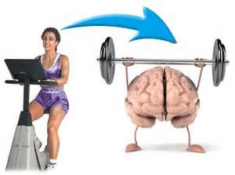
Opinion Writing In Primary: Exercise and the Brain
Adapted by Jean Wolph from NWP i3 materials and lesson sequence by Angel Peavler, KWP RSPDI Team

Slide 2
Is exercise important for learning? What do you think?
I’ve never thought about the connection between learning and exercise.
I don’t know whether exercise is important for learning.
I think exercise might be important for learning, but I don’t know why.
It makes sense that exercise can help you learn.
OR: _______________________________
Capturing our thinking

Slide 3
Starting Our Flip Book
https://staffkyschools-my.sharepoint.com/personal/angel_peavler_fayette_kyschools_us/_layouts/15/WopiFrame.aspx?sourcedoc=%7BDA8E80CD-E33C-4A31-89A0-B30312662648%7D&file=KWP&action=default
Is exercise important for learning?

Slide 4
Is exercise important for learning?
Text #1
Study the images. Turn and talk: What do you notice about these two brain scans? What do you think could explain the difference?

Slide 5
What Did We Say in Partner Talks?
After walking, the brain is different. I notice that _______________________.
There is a change in the brain after you get some exercise. It looks like __________.
Brain scans show that our brains change after we walk for 20 minutes. I wonder why that is.
___________________________________
Capturing our thinking

Slide 6
Continuing Our Flip Book
https://staffkyschools-my.sharepoint.com/personal/angel_peavler_fayette_kyschools_us/_layouts/15/WopiFrame.aspx?sourcedoc=%7BDA8E80CD-E33C-4A31-89A0-B30312662648%7D&file=KWP&action=default
Is exercise important for learning?
First I thought…

Slide 7
Flip the first flap: First I thought…
First I thought…
Use the space to explain your thinking. You may use sentences we wrote as a class or you may write your own sentences.

Slide 8
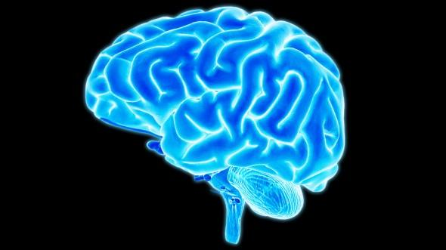
Let’s READ and RESEARCH to find out more!
Your Amazing Brain
National Geographic Kids Magazine http://kids.nationalgeographic.com/explore/science/your-amazing-brain/#
You carry around a three-pound mass of wrinkly material in your head that controls every single thing you will ever do. From enabling you to think, learn, create, and feel emotions to controlling every blink, breath, and heartbeat—this fantastic control center is your brain. It is a structure so amazing that a famous scientist once called it "the most complex thing we have yet discovered in our universe."
Text #2

Slide 9
Your Amazing Brain National Geographic Kids Magazine http://kids.nationalgeographic.com/explore/science/your-amazing-brain/#
Your brain is faster and more powerful than a supercomputer.

Slide 10
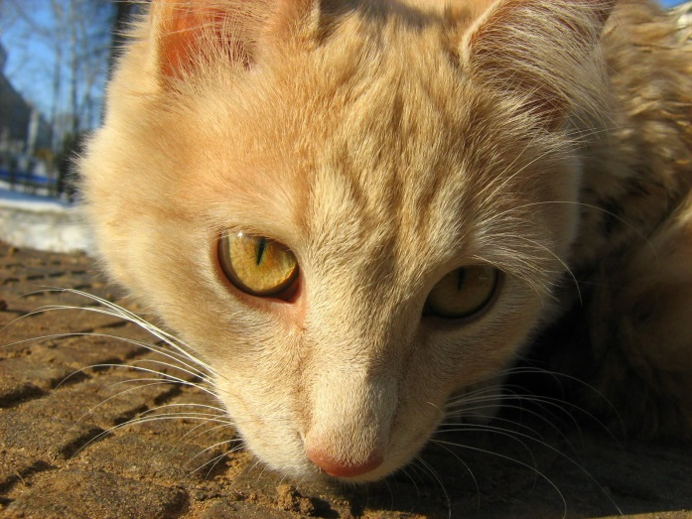
Your Amazing Brain National Geographic Kids Magazine http://kids.nationalgeographic.com/explore/science/your-amazing-brain/#
Your kitten is on the kitchen counter. She's about to step onto a hot stove. You have
only seconds to act. Accessing the signals coming from your eyes, your brain quickly calculates when, where, and at what speed you will need to dive to intercept her. Then it orders your muscles to do so. Your timing is perfect and she's safe. No computer can come close to your brain's awesome ability to download, process, and react to the flood of information coming from your eyes, ears, and other sensory organs.

Slide 11
Your Amazing Brain National Geographic Kids Magazine http://kids.nationalgeographic.com/explore/science/your-amazing-brain/#
Your brain generates enough electricity to power a lightbulb.

Slide 12
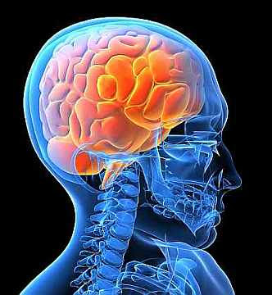
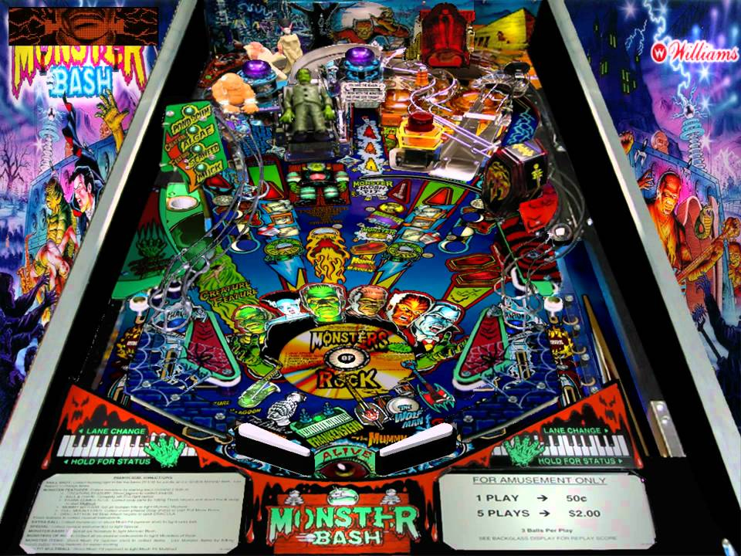
Your Amazing Brain National Geographic Kids Magazine http://kids.nationalgeographic.com/explore/science/your-amazing-brain/#
Your brain contains about 100 billion microscopic cells called neurons—so many it would take you over 3,000 years to count
them all. Whenever you dream, laugh, think, see, or move, it’s because tiny chemical and elec-trical signals are racing between these neurons along billions of tiny neuron highways. Believe it or not, the activity in your brain never stops. Countless messages zip around inside it every second like a supercharged pinball machine. Your neurons create and send more messages than all the phones in the entire world. And while a single neuron generates only a tiny amount of electricity, all your neurons together can generate enough electricity to power a low-wattage bulb.

Slide 13
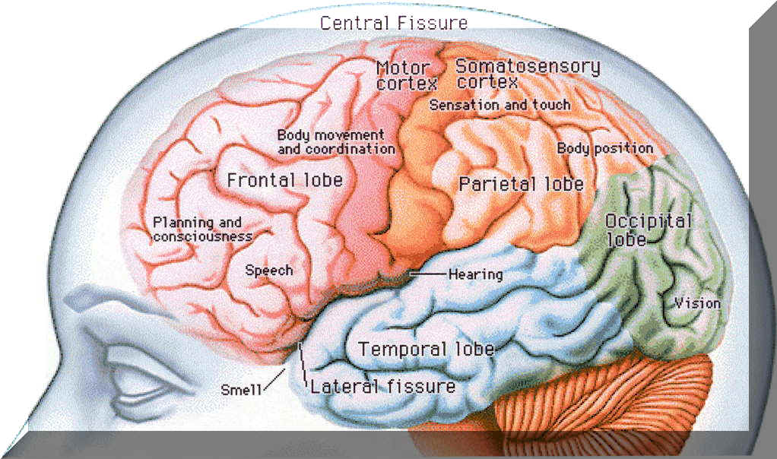
Your Amazing Brain National Geographic Kids Magazine http://kids.nationalgeographic.com/explore/science/your-amazing-brain/#
Neurons send info to your brain at more than 150 miles (241 kilometers) per hour.
A bee lands on your bare foot. Sensory neurons in your skin relay this information to your spinal cord and brain at a speed of more than 150 miles (241 kilometers) per hour. Your brain then uses motor neurons to transmit the message back through your spinal cord to your foot to shake the bee off quickly. Motor neurons can relay this information at more than 200 miles (322 kilometers) per hour.

Slide 14
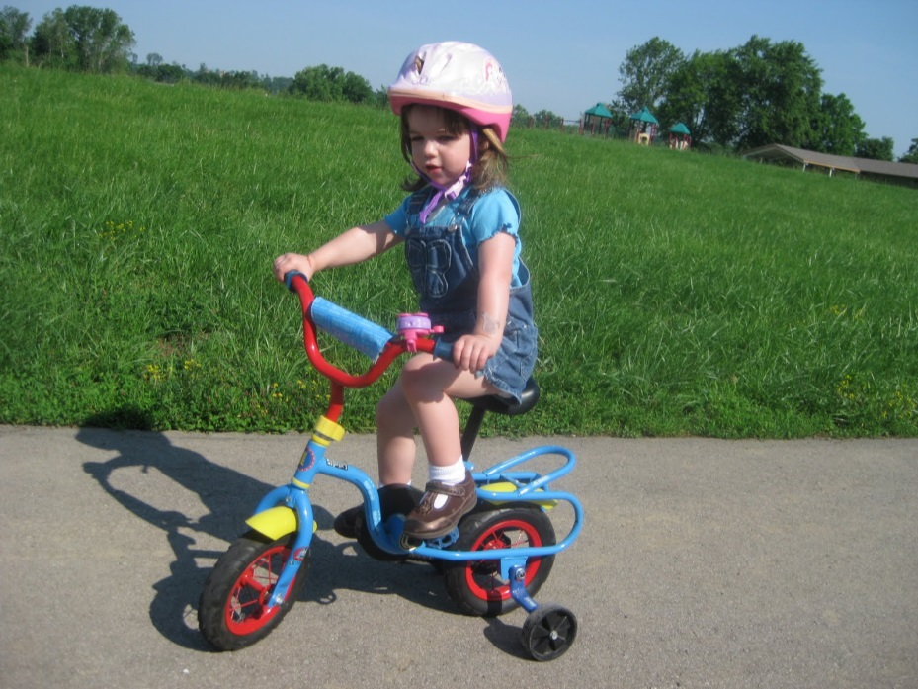
Your Amazing Brain National Geographic Kids Magazine http://kids.nationalgeographic.com/explore/science/your-amazing-brain/#
When you learn, you change
the structure of your brain. Riding a bike seems impossible at first. But soon you master it. How? As you practice, your brain sends "bike riding" messages along certain pathways of neurons over and over, forming new connections. In fact, the structure of your brain changes every time you learn, as well as whenever you have a new thought or memory.

Slide 15
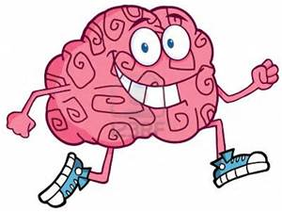
Your Amazing Brain National Geographic Kids Magazine http://kids.nationalgeographic.com/explore/science/your-amazing-brain/#
Exercise helps make you
smarter. It is well known that any
exercise that makes your heart beat faster, like running or playing basketball, is great for your body and can even help improve your mood. But scientists have recently learned that for a period of time after you've exercised, your body produces a chemical that makes your brain more receptive to learning. So if you're stuck on a homework problem, go out and play a game of soccer, then try the problem again. You just might discover that you're able to solve it.

Slide 16
Let’s capture things we learned about Exercise and the Brain

Slide 17
Adding Facts to Our Flip Book
https://staffkyschools-my.sharepoint.com/personal/angel_peavler_fayette_kyschools_us/_layouts/15/WopiFrame.aspx?sourcedoc=%7BDA8E80CD-E33C-4A31-89A0-B30312662648%7D&file=KWP&action=default
Is exercise important for learning?
First I thought…
Then I learned…

Slide 18
Flip the next flap: Then I learned…
Then I learned…
Use the space to explain facts about exercise and learning. You may use sentences we wrote as a class or you may write your own sentences.

Slide 19
A Science Experiment
Text #4
Exercise & Memory by Jada and Maurna (5.1)--DragonflyTV
We heard that exercise can make our brain work better, but we wanted to know if that was true. Maybe it could be the answer to getting good grades at school. For our DragonflyTV investigation, we asked: Can exercise improve a person's memory?
What did we do? To make a memory test, we grabbed 25 different things from around the house and covered them up with a towel. Next, we asked eight of our friends to take a test. We removed the towel and gave them one minute to stare at the items. When the minute was up, we covered the objects again and asked them to write down as many objects as they could remember. Then we split our friends into two groups. One group played board games (Team Slack Attack); the other group ran an exercise obstacle course (Team Jumping Jacks). Meanwhile, we put new items in the memory test. After 10 minutes, both teams took a second memory test with the new items.
What did we find out? We graded all the tests, giving one point for each correct answer. Then we made a chart that showed how each team's score changed. The Slack Attack's average score decreased by 2 points. The Jumping Jacks' average increased by 4 points. The improvement wasn't huge, but the team that exercised increased their memory test scores, while the group that sat still actually did worse on the second test. We thought that you'd have to exercise for a long time in order to really see the effects.
What can you do?
What's your favorite sport or exercise? Does long term exercise help you remember things better? Chart your physical activity over a few months and compare it to a memory test that you take every few weeks. Do your scores increase over time?

Slide 20
Let’s capture things we learned about Exercise and the Brain

Slide 21
Use the back of the flap: Then I Learned…
Then I Learned…
Use the space to explain facts about exercise and learning that we discovered from the memory experiment. You may use sentences we wrote as a class or you may write your own sentences.

Slide 22
Finishing Our Flip Book
https://staffkyschools-my.sharepoint.com/personal/angel_peavler_fayette_kyschools_us/_layouts/15/WopiFrame.aspx?sourcedoc=%7BDA8E80CD-E33C-4A31-89A0-B30312662648%7D&file=KWP&action=default
Is exercise important for learning?
First I thought…
Then I learned…
Now I think…

Slide 23
Flip the last flap: Now I think…
First I thought…
Use the space to explain your thinking. Now that you’ve done the research, what do you think about the brain and exercise? You may use sentences we wrote as a class or you may write your own sentences.

Slide 24
Sharing
Read your flip book to your partner.
Talk about ways you plan to use exercise to get smarter!

Slide 25
Let’s Try It!
Brain Fitness Exercises. Make you smart, Brain activation.Right Brain exercise (YouTube)
<iframe width="1280" height="750" src="//www.youtube.com/embed/afMOUmOynRI" frameborder="0" allowfullscreen></iframe>

Slide 26
Something to think about…why do you think this saying by Confucious has been preserved for thousands of years?
I hear and I forget.
I see and I remember.
I do and I understand.
--Confucius

