Slide 1
Rubric Basics KY Writing Project Conference September 12, 2015
carol.franks@education.ky.gov
rebecca.woosley@education.ky.gov

Slide 2
TARGETS
I can evaluate rubrics for quality.
I can identify when a rubric is congruent to expectations of grade level standards.
I have a fundamental understanding of how rubric development and use supports the student growth goal-setting process.
Notes:
Our goal is for you to be able to evaluate rubrics you already have, those you find on-line or elsewhere, and those you may create. Additionally, we want to support you in understanding how to develop a quality rubric. A very important aspect of a quality rubric is its congruency to standards. We’ll end by looking at the connections to the SG goal-setting process.

Slide 3
Why rubrics?
“Think of a fully developed rubric as a description of levels of understanding, proficiency, or quality along a continuum or scale.”
--Jay McTighe
“ When the intended learning outcomes are best indicated by performances—things students would do, make, say, or write—then rubrics are the best way to assess them.”
--Susan Brookhart
Notes:
Our goal is the focus on higher order thinking and reasoning.

Slide 4
The Problem with Rubrics
Your group (of section of the room) will be assigned an element of the article.
Read independently.
Be prepared to share the “bottom line” in one sentence.
Ah-has?
Notes:
Provide the 5 examples of problems with rubrics on CASL pages 205-210 (below). Divide the room into groups and assign a problem to each. After they read independently – 3 minutes. Ask one person from each group to share a one sentence ‘bottom line.”
Counting, when quality is more important than quantity
Important details left out
Irrelevant details in a rubric
Student-friendly rubrics where anything goes
Skimpy scoring guides
Share our any Ah-ha’s whole group

Slide 5
Counting when quality is more important than quantity
Leaving out important details that define learning
Including irrelevant details – Go for important!
Allowing “anything goes” in student-friendly rubrics – Guide students to identify quality!
Settling for skimpy “rubric samplers” – Descriptive language defines and differentiates quality. The rubric in NOT just a score guide.
Notes:
Keep the Bottom Line in mind when creating rubrics

Slide 6
Holistic vs. Analytical
Holistic Rubrics
-provide an overall description of quality
-used for summative assessment
-performance levels used to identify a score
-cannot be used for descriptive feedback

Slide 7
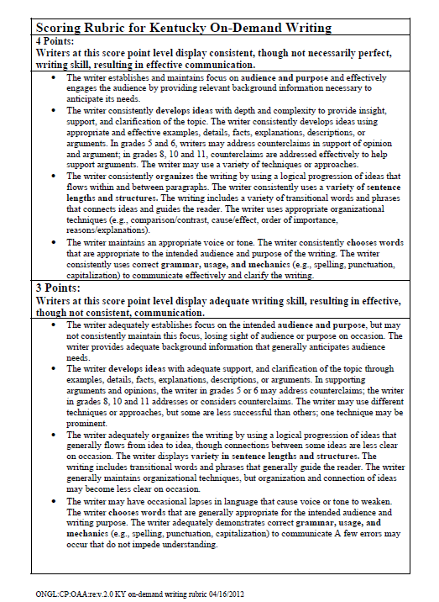
The Kentucky on-demand scoring rubric is a Holistic Rubric.

Slide 8
Holistic vs. Analytical
Holistic Rubrics
-provide an overall description of quality
-used for summative assessment
-no performance levels
-cannot be used for descriptive feedback
Analytical Rubrics
-provide description of quality
-used for formative and summative assessment
-descriptive performance levels for each criteria
-can be used for descriptive feedback
Notes:
Our goal is the development of analytical rubrics for these purposes.

Slide 9
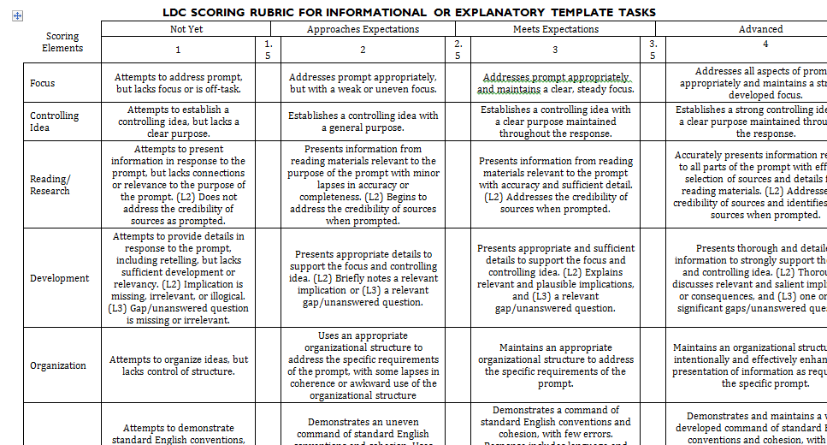
Scoring criteria
Performance levels
The LDC scoring rubric is an analytical Rubric.
Descriptive language
Notes:
The LDC rubric is an Analytical rubric.
Performance levels (1 to 4) leading up to proficiency and beyond proficiency
Important criteria for meeting the intent of the standard (the scoring elements or scoring criteria)
Descriptive language for criteria at each level of performance

Slide 10
Activity: What should a rubric do?
With your elbow partner, look over the sample rubric.
Discuss what a rubric should do.
Notes:
Provide some sample rubrics for table teams to look over. Then, ask them to create a list of what rubrics can do – they can use the back of the 11x17 LDC rubric sample.
5 minutes then 5 more for discussion with next slide

Slide 11
What rubrics should do (CASL, pg.200)
Define quality for ourselves.
Describe quality for students.
Make judgments more objective, consistent, accurate.
Guide instructions
Provide a common language.
Promote descriptive feedback to students.
Promote student self-assessment and goal-setting.
Make expectations for students explicit.
Eliminate bias.
Focus teaching.
Track student learning.
Notes:
What would you add to your list?

Slide 12
Tool for Evaluating Instructional Rubrics
Notes:
Review the Evaluating Instructional Rubrics Tool. (see activity on next slide)

Slide 13
Activity: Applying the Evaluating Instructional Rubrics Tool
You have:
An LDC argumentative rubric
Handout - Evaluating Instructional Rubrics Tool
With your assigned group:
Be prepared to describe one way the LDC argumentative rubric meets the criteria assigned to your group.
Notes:
Provide an LDC argumentative rubric for all participants. 15 minutes for activity (may not need that long)

Slide 14
Congruency to Standards
The description of proficiency is congruent with the level of rigor intended for the standard(s) being assessed.
The criteria included in the rubric are important to defining all aspects of proficiency.
Notes:
You may have had trouble confirming that the LDC rubric met these descriptors in the Tool for Evaluating Instructional Rubrics. In order to do this, you need to have a good understanding of the standards you are developing the rubric around. Often the verbs in the standards provide the level of complexity of the standard. Those of you that work with LDC know that this rubric is congruent with the expectations of the standards.

Slide 15
Reliability & Validity
The rubric is appropriate for the skills/tasks it is used to assess; it can be used to assess what it is intended to assess.
The rubric leads to the same or similar scores regardless of scorer.
Notes:
You may have also had trouble with these descriptors. You really will not know the appropriateness of the rubric and fit to the task until you try it out with sudent work. can’t do this until you have

Slide 16
Making Connections: Rubrics & Student Growth Goal Setting within the Professional Growth and Effectiveness System (PGES)
Notes:
Transition slide to start making the connection between SG goal-setting and use of rubrics.

Slide 17
Rubrics and Student Growth Goal-Setting
An analytic rubric can help teachers combine multiple sources of data to –
determine a baseline score for goal-setting
determine if students met the goal at the end of the course, and
formatively assess, provide feedback, and adjust instruction along the way

Slide 18
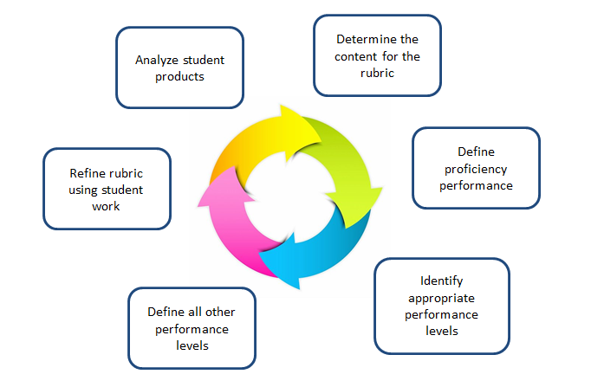
Rubric Design: A Recursive Process
Notes:
Provide the handout: Designing an Analytical Rubric and time to read through the document. 3 minutes to read
Pass out “My example: from ES to GL standards” packet while participants read.

Slide 19
Rubric Design: A Recursive Process
Notes:
Provide the handout: Designing an Analytical Rubric and time to read through the document. 3 minutes to read
Pass out “My example: from ES to GL standards” packet while participants read.

Slide 20
Rubric Design: A Recursive Process
Notes:
Provide the handout: Designing an Analytical Rubric and time to read through the document. 3 minutes to read
Pass out “My example: from ES to GL standards” packet while participants read.

Slide 21
Rubric Design: A Recursive Process
Notes:
Provide the handout: Designing an Analytical Rubric and time to read through the document. 3 minutes to read
Pass out “My example: from ES to GL standards” packet while participants read.

Slide 22
Rubric Design: A Recursive Process
Notes:
Provide the handout: Designing an Analytical Rubric and time to read through the document. 3 minutes to read
Pass out “My example: from ES to GL standards” packet while participants read.

Slide 23
Rubric Design: A Recursive Process
Notes:
Provide the handout: Designing an Analytical Rubric and time to read through the document. 3 minutes to read
Pass out “My example: from ES to GL standards” packet while participants read.

Slide 24
A checkpoint for quality
“The content has the “ring of truth”—your experience as a teacher confirms that the content is truly what you do look for when you evaluate the quality of a student performance or product. In fact, the rubric is insightful: it helps you organize your own thinking about what it means to perform well.”
--Creating & Recognizing Quality Rubrics, Copyright @2006 Educational Testing Service
Notes:
You won’t know this until you try out the rubric with student work.

Slide 25
Engaging Students
Students rewrite rubrics in
student-friendly language
Students use models to
identify criteria for quality
Students analyze poor models using the rubric and identify how to improve
Students develop rubrics
Students use rubrics to provide peer feedback
Notes:
Engaging students in this process is key. Helping students become owners of their learning helps them become successful learners.
Some ways to engage students are:
Students rewrite rubrics in student-friendly language
Students use models to identify criteria for quality
Students analyze poor models using the rubric and identify how to improve
Students develop rubrics
Students use rubrics to provide peer feedback
Note that using rubrics in this way aligns with proficient and distinguished levels of your program reviews – just look over the Formative and Summmative standard demonstrators.
Not only are their clear connections to PRs, but also to the Framework for Teaching – supports clear communication with students, supports student engagement, supports using assessment in instruction (students are aware of assessment criteria, feedback from teacher and peers, self-assessment)

Slide 26
Engaging Students
“ Effective rubrics show students how they will know to what extent their performance passes muster on each criterion of importance, and if used formatively can also show students what their next steps should be to enhance the quality of their performance.”
--Susan Brookhart
Notes:
Our goal is that higher order thinking and reasoning.

Slide 27
Rubrics and Student Growth Goal-Setting
An analytic rubric can help teachers combine multiple sources of data to –
determine a baseline score for goal-setting
determine if students met the goal at the end of the course, and
formatively assess, provide feedback, and adjust instruction along the way

Slide 28
Our Targets
I can evaluate rubrics for quality.
I can design a quality rubric congruent to expectations of grade level standards.
I understand how rubric development and use supports the student growth goal-setting process.
Next Session 1:30 – Designing Standards-Based Rubrics

Slide 29
Resources
Jay McTighe’s Lumibook on PD360, Assessing What Matters Most (2013) (chapter 6)
Stiggins, Arter, Chappuis & Chappuis, Classroom Assessment for Student Learning: Doing it Right – Using it Well (2006) (chapter 7)
Brookhart, Susan (2013) How to Create and Use Rubrics for Formative Assessment and Grading
Andrade, Heidi G. Using Rubrics to Promote Thinking and Learning(Feb 2000)
Educational Testing Service, Creating & Recognizing Quality Rubrics CD (2006)
Analytic Rubrics, DePaul University Teaching Commons

Slide 30
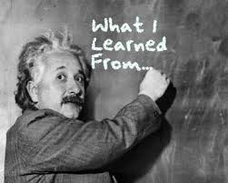
What will you take away from today’s work with rubrics?
What are your next steps?
Notes:
Share take-aways if time permits.

