Slide 1
Response to Bullying
Opinion Mini-Unit
Mary-Adele Allison, RSPDI
January 2016
Lessons adapted from materials developed by Jean Wolph, Louisville Writing Project and
the National Writing Project i3 College Ready Writers Program, funded by the Department of Education.

Slide 2
 |  | Writing |  | Reading |  | Topic
Argument MINI-UNIT Emphasis | ARGUMENT SKILLS | PRODUCT | ELEMENTS OF ARGUMENT | CLOSE READING STRATEGIES | RESPONSE TO READINGS | TOPICS
# of lessons |  | Draft, Feedback, Revise, Reflect |  | Close reading strategies | Writing & talking to develop knowledge on topic or issue
Using text-based evidence to support an opinion Writing for an audience 7-9 lessons | Entering Skills: Close Reading for a purpose Foundational Skills It Says/I Say Chart Peer conferencing Giving text-based evidence Digging Deeper: Connecting to the audience | Kernel Essay: A Memory/Scenario → Some People Think → I know we should → Reasons it would be effective | Researching to make an informed decision Writing for an audience Providing clear, logical reasons to support an opinion Using a counter move (Harris) | It Says, I Say Chart Identifying the meaning in illustrations Reading/ highlighting poetry for a purpose Close Reading/ highlighting a text for evidence | Scaffolded writing: A Memory/Scenario →Some People Think →I know we should →Reasons it would be effective Choices of audience: Bystander Person being bullied | How to Respond to Bullying? 3 illustrations Bullying 101 packet (pdf) 3 videos Song/Poem (Butterfly) article

Slide 3
Writing Standards Emphasized in this Mini-Unit:
Write an opinion piece in which they introduce the topic.
Write an opinion piece in which they state an opinion, providing reasons and evidence.
Providing a counter argument in an opinion piece.
Writing an opinion piece in which they write a concluding paragraph.

Slide 4
Mini-Unit Sequence
 | Each day’s lesson is approximately 30 minutes.
Day 1 | Slides 4-7 The class will analyze images of bullying. They will Think, Write, Share about bullying (definition & personal experience).
Days 2 & 3 | Slide 8 The class will research bullying with the Bullying 101 pamphlet. They will take notes on the It Said/My Thoughts chart.
Day 4 | Slides 9-11 The class will watch 3 videos about bullying. These videos provide personal reactions to bullying. Lizzie Slider video: They will find a message in her lyrics. D’s video: Students will react to the way the basketball players, coach, and school reacted to bullying. Student Video: Students will react to the solutions provided in the scenarios presented. (All reactions will be recorded on the It Said/My Thoughts chart.)
Day 5-7 | Slides 12-15 Students will walk through steps to create a rough draft for the essay. (Memory/Scenario) ➔ (Some people think…) ➔ (I think we should) ➔ (Reasons effective) All charts are included with the It Said/My Thoughts chart. Students will evaluate their claim for effectiveness, cite a source, and supply reasons for their claim. When finished, students will peer conference.

Slide 5
Day 1: Think, Pair, Share What is happening in this image?
What do you think is happening in the picture?
How do you know?
What do you see in the picture that is telling the story?
http://www.bing.com/images/search?q=kids+bullying+clipart&view=detailv2&qft=+filterui%3alicense-L2_L3_L4_L5_L6_L7&id=EC836F42C2480C5F0F4CC0B635449EEE023A32C1&selectedIndex=1&ccid=vf%2fVQVZh&simid=608033706305130250&thid=OIP.Mbdffd5415661f4873ab0cfc7c65d9225H0&ajaxhist=0
Notes:
Day 1: At this point, we are only introducing the subject. You might have charts with the picture attached at the top and record the students thoughts on each. You can reflect back on these after they have finished studying bullying. You might also set this up as group work. Assign a picture to each team and then, asking them to record their thoughts under the picture and report out. (Note: Not all of these pics are considered bullying. Have kids look at the expressions on the faces or other clues that would tell you whether it is play or bullying. There are no right or wrong answers. Their evidence, reasons, and discussions are important at this point.)

Slide 6
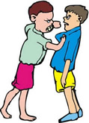
Day 1: Think, Pair, Share What is happening in this image?
What do you think is happening in the picture?
How do you know?
What do you see in the picture that is telling the story?
http://www.bing.com/images/search?q=kids+bullying+clipart&view=detailv2&qft=+filterui%3alicense-L2_L3_L4_L5_L6_L7&id=BEEBC8F23BB4A77807A6BD573493E07B8FE0A077&selectedindex=15&ccid=0qps2UJ3&simid=608012175627780948&thid=OIP.Md2aa6cd9427742b628e7926fa417a530o0&mode=overlay&first=1
Notes:
Day 1: At this point, we are only introducing the subject. You might have charts with the picture attached at the top and record the students thoughts on each. You can reflect back on these after they have finished studying bullying. (Note: Not all of these pics are considered bullying. Have kids look at the expressions on the faces or other clues that would tell you whether it is play or bullying. There are no right or wrong answers. Their evidence, reasons, and discussions are important at this point.)

Slide 7
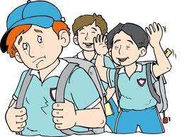
Day 1: Think, Pair, Share What is happening in this image?
What do you think is happening in the picture?
How do you know?
What do you see in the picture that is telling the story?
Notes:
Day 1: At this point, we are only introducing the subject. You might have charts with the picture attached at the top and record the students thoughts on each. You can reflect back on these after they have finished studying bullying. (Note: Not all of these pics are considered bullying. Have kids look at the expressions on the faces or other clues that would tell you whether it is play or bullying. There are no right or wrong answers. Their evidence, reasons, and discussions are important at this point.)

Slide 8
Day 1: So, what is bullying?
Think, Write, Share:
What do you think bullying is? Write it down. Be prepared to share your answer with a neighbor.
Think and Write – We will not share these.
Write down a memory you have of bullying.
Did you see someone else get bullied?
Have you been bullied by someone else?
Have you ever bullied someone else?
Notes:
These are just quick jots. The students might use these reflections later when they write their opinion piece.

Slide 9
Let’s do a little research…
Read the pamphlet called Bullying 101 to expand our knowledge of the subject. Take notes reflecting on your own thoughts.
http://www.pacerkidsagainstbullying.org/wp-content/uploads/2014/07/bullying1011.pdf
Notes:
Have students take notes in the Response booklet. After each page, they will circle, underline or highlight a section of the text that draws their attention. Then, they write a reaction to it in the My Thoughts section. The reaction can be a connection, an agreement or disagreement, elaboration of the idea, or an emotion. Give students a chance to share their thoughts. This might take you 2-3 days to read and discuss.

Slide 10
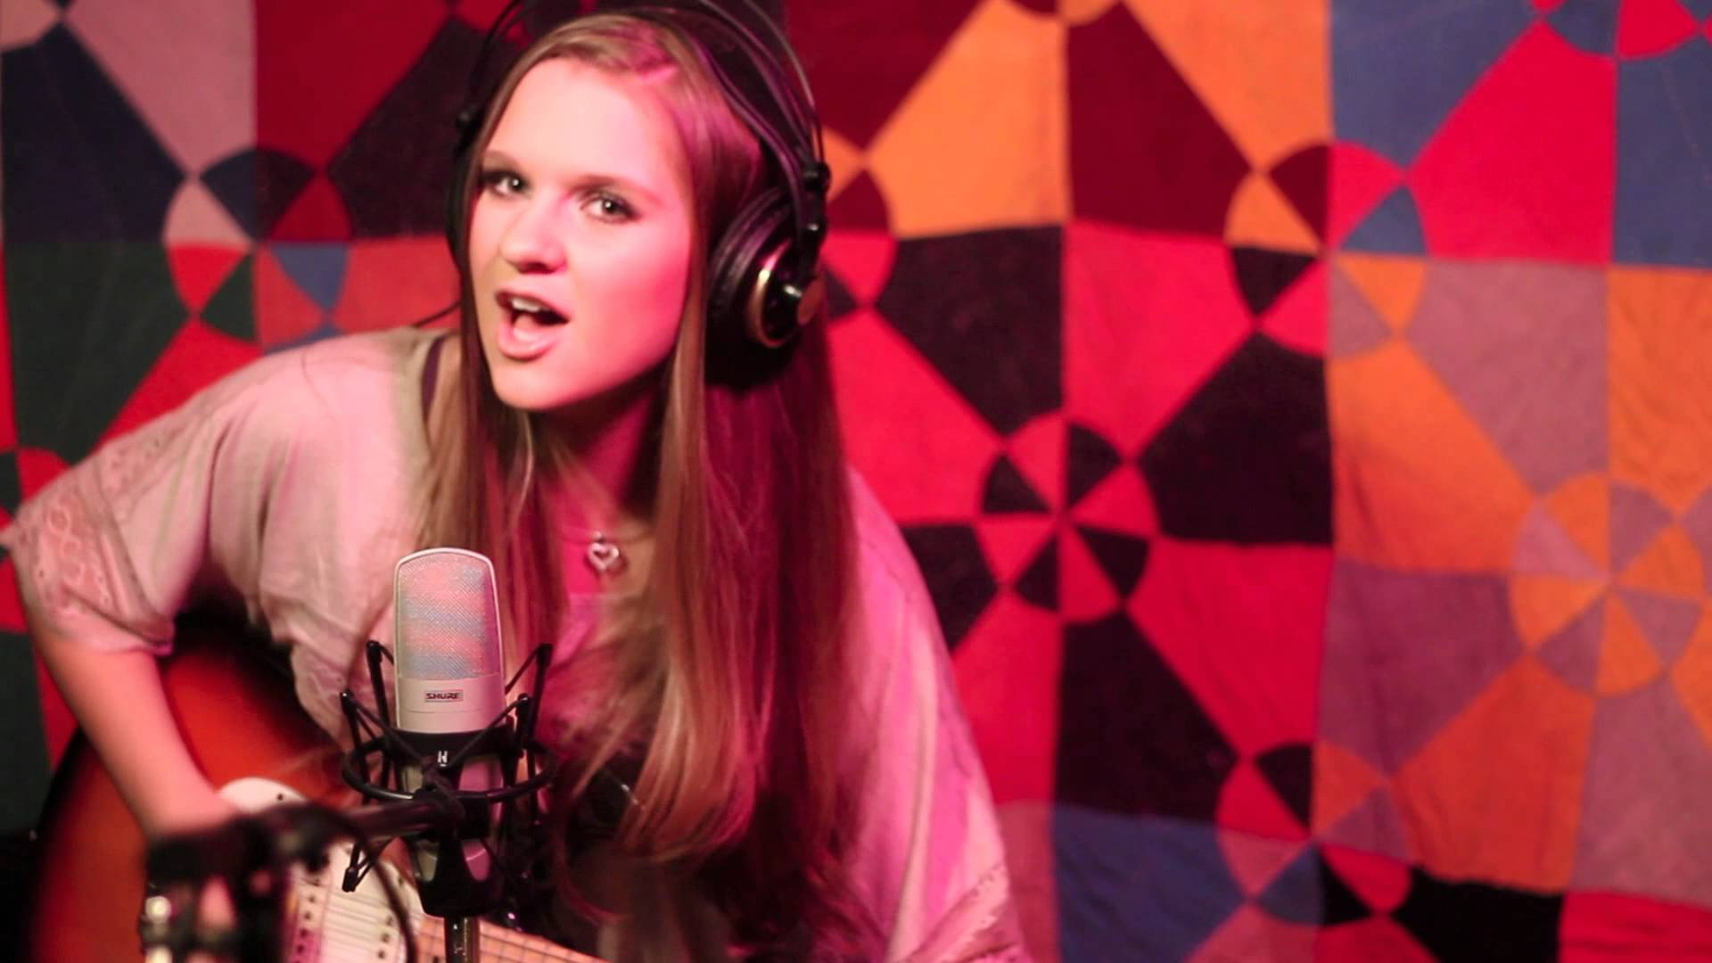
Let’s Listen to a Singer, Lizzie Sider, sing about her experience.
https://www.youtube.com/watch?v=KJuu1hKo-u8
Step 1: Watch the video and enjoy it.
Step 2: Working with a partner: Read the lyrics. Use a highlighter to highlight the words that show that she experienced bullying.
Step 3: Share out.
https://www.google.com/search?q=picture+of+Butterfly+video+lizzie+sider&tbm=isch&tbo=u&source=univ&sa=X&ved=0ahUKEwjQy9iU5cDKAhXLWT4KHSXpDkkQ7AkINA&biw=1467&bih=723#imgrc=0kBx5URZAK_mUM%3A
Notes:
Day 4: The next three slides provide videos that will help students think about bullying. The students can continue to take notes on their Response Booklet. This song highlights the effects of bullying while spreading the message that you can overcome it. The lyrics are provided in the Response Booklet.

Slide 11
Look at what these basketball players did in the face of bullying!
Let’s watch the video:
https://www.youtube.com/watch?v=Kg1ONpbAUCE
Notes:
Day 4: In this video, a basketball team stands up for a cheerleader with Down Syndrome. On their chart, students record what they saw and their reaction. The reaction can be a connection, a summary, an agreement or disagreement, elaboration of the idea, or an emotion. Give students a chance to share their thoughts.

Slide 12
Let’s wrap up our research with a video created by students
https://www.youtube.com/watch?v=6tfwR0VikQ0
Notes:
Day 4: This video gives examples of what students can do in the face of bullying. There are several scenarios. The student charts provide room for their reactions to each scenario.

Slide 13
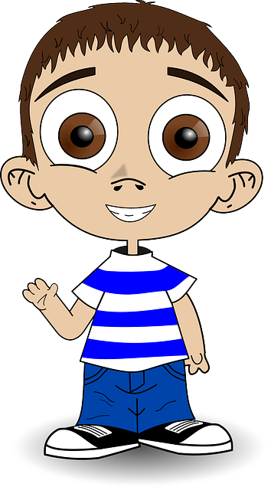
What are your thoughts?
We are going to write an essay about bullying.
In this essay, you are going to tell the audience what you think they should do if they experience bullying.
You can either provide strategies for
someone that is being bullied
a bystander who witnesses bullying.
You will need to provide reasons for your claim.
First, we need plan for the piece:
or
A memory or scenario
Some people think…
I know we should…
Reasons it would be effective
Notes:
Day 5-7 The plan is provided in their Response Booklet. Give students a packet of 4 pieces of blank paper. They write each section on a different page, skipping lines – makes it easier to revising and editing.

Slide 14
Did you notice???
Each of our videos was like a little essay.
Each had a very clear message or main idea they wanted the viewer to know.
Let’s look at your notes.
What message did Lizzie Slider want the viewer or audience to know?
How did each video persuade you?
Did you notice that they used stories – stories from their lives or scenarios that might have happened?
This helps the audience care about the topic.
In our essay, we will start with a story from our life or a scenario.
For the next 2 minutes, we will brainstorm scenarios or memories that we can use. Just write a quick list.
What message did the basketball players want the bullies to know about D?
What message did the Eagle Scouts want students to know about bullying in their video?
You’re right! She wanted the audience to know that she was able to rise above the bullying that she experienced.
Correct! They wanted the bullies to realize how very special D is and that all people should be treated with kindness.
Great Job! They wanted us to know that you can beat bullying by standing up for the bully and being kind.
Now, take a moment to choose one that you think would be more powerful to the reader – one that the reader will care about. Write the topic in the first box of your plan.
On notebook paper, write a paragraph narrating that scenario. Use words that will bring the story alive for your reader. Be sure to skip lines – for revising later.
Notes:
Day 5-7 There is room for the brainstorming in the Response booklet. Give the students notebook paper to write their rough drafts. They should leave every other line blank – for revising later.

Slide 15
What advice did some adults
give in the past?
Let’s look at pages 14-15 of the Bullying 101 pamphlet.
http://www.pacerkidsagainstbullying.org/wp-content/uploads/2014/07/bullying1011.pdf
What poor advice do some people think you should give to someone in your scenario?
Write these ideas in the “Some people think” box on your plan.
On notebook paper, write a sentences identifying what some people think. (Be sure to skip lines – for revising later.)
Here are some stems to help out:
Some people think…. I heard someone say…
When ___ talked to ___, he/she was told to…
Notes:
Day 5-7 There is room for the brainstorming in the Response booklet. Give the students notebook paper to write their rough drafts. They should leave every other line blank – for revising later.

Slide 16
Now, It’s Time to Strategize
Next, we will write down strategies that you would want the reader to use when faced with this problem.
A strong argument backs up its claim with evidence. The strategy we choose is our claim. So, we want to go back to the experts to find effective strategies. We have the Bullying 101 pamphlet notes and the videos we watched.
Let’s also check out this article: http://pbskids.org/itsmylife/friends/bullies/article4.html
This time, you and a partner will scan this text – looking for effective strategies to your scenario.
Record the strategies from the videos or articles on the chart below and write down the reason someone should use the strategy.
Questions to ask yourself: What would be the effect of the choice?
Would there be any consequences?
Who would it help? How would it help?
Would it provide a lasting help?
Strategy | Which article or video? | Reasons for using this strategy | Effectiveness (Excellent, OK, Not effective)
Notes:
Day 5-7 There is room for the brainstorming in the Response booklet. Give the students notebook paper to write their rough drafts. They should leave every other line blank – for revising later.

Slide 17
You have just determined
Your claim and Evidence
The claim is the opinion that you are asserting.
You claim that the reader should ___________ when faced with the bullying you described in your scenario.
You have also identified the source of your strategy – the article or video that recommended it.
By citing your source, you are strengthening your argument.
Write a paragraph stating your claim and evidence. Be sure to skip lines – for revising later.
Here are some stems you might find useful:
In this situation, a child should _______________.
When faced with this problem, we should ___________________.
We should __________________ when _________________________
“As [article or video title] says, “
“The video [title] explains …”
“ According to …”
“Although the [article or video title] says …”
Notes:
Day 5-7 There is room for the brainstorming in the Response booklet. Give the students notebook paper to write their rough drafts. They should leave every other line blank – for revising later.

Slide 18
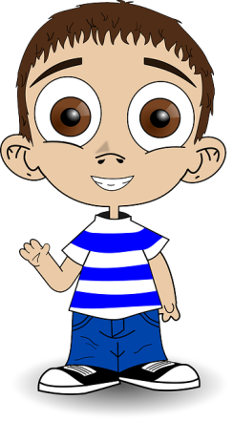
What about those reasons?
You have your claim and evidence from the experts.
What about the reasons you explored?
Why was that strategy more effective?
What would happen?
Who would it help?
Why would the advice you discussed in the “Some people say…” not be as effective? Are there consequences?
Look over your claims paragraph. Have you included these reasons?
Do you feel that your argument proves that your strategy is the better choice?
If not, add the rest of your supporting argument.
Share your Argument with a friend
Switch papers with another student. Each of you should look for a strong claim supported by evidence and reasons.
Write one compliment on a post-it citing the evidence or reason you liked.
Notes:
Day 5-7 There is room for the brainstorming in the Response booklet. Give the students notebook paper to write their rough drafts. They should leave every other line blank – for revising later.

Slide 19
Congratulations!
Now, you have a rough draft using this structure!
A memory or scenario
Some people think…
I know we should…
Reasons it would be effective
Notes:
Day 7

