Slide 1
Argument Highway: A Metaphor

Slide 2
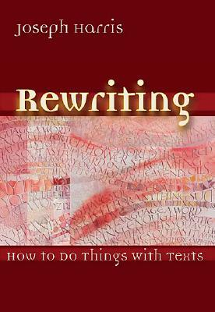
Argument Highway
An instructional metaphor based on
Rewriting: How to Do Things with Texts
by Joseph Harris

Slide 3
The Argument Highway
Argument Highway is a metaphor for the ways good writers use and respond to source material.
The highway represents the ongoing conversations of argument in which people engage every day.
The road is the texts, or source material, upon which these arguments are based.

Slide 4
Argument is students making choices about where they want to go with claims, and how they want to get there – choices of vehicles, roads, and destinations in writing.

Slide 5
Those arguments help them engage with larger, ongoing conversations about all kinds of issues.

Slide 6
Terms to Know: The Road
The road is the texts and source material that provide the basis for argument.

Slide 7
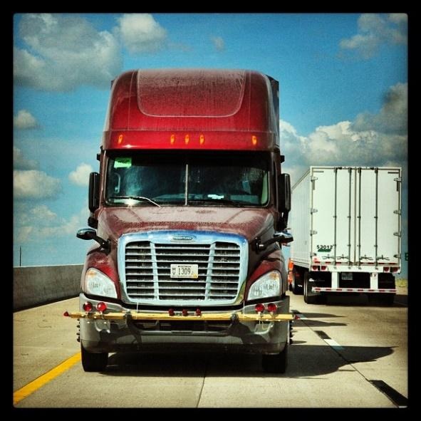
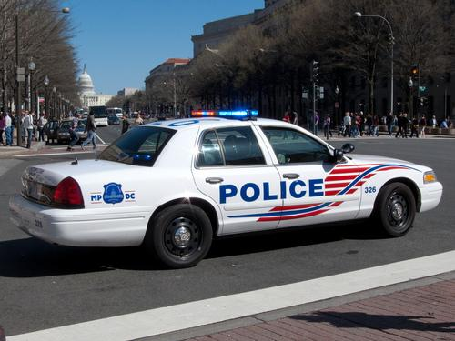
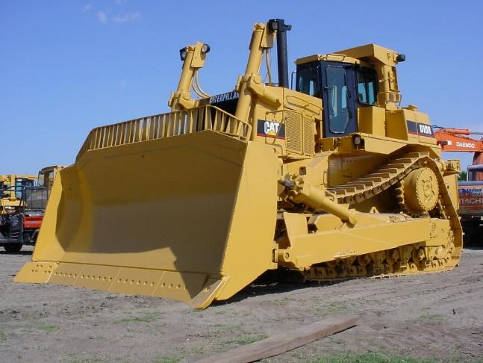
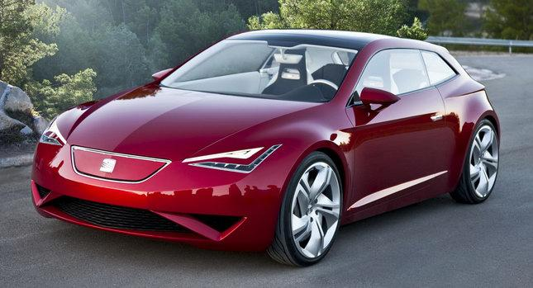
Terms to Know: The Vehicles
The vehicles represent the ways students quote and use source material – the deliberate and specific moves writers make to forward and counter texts.

Slide 8
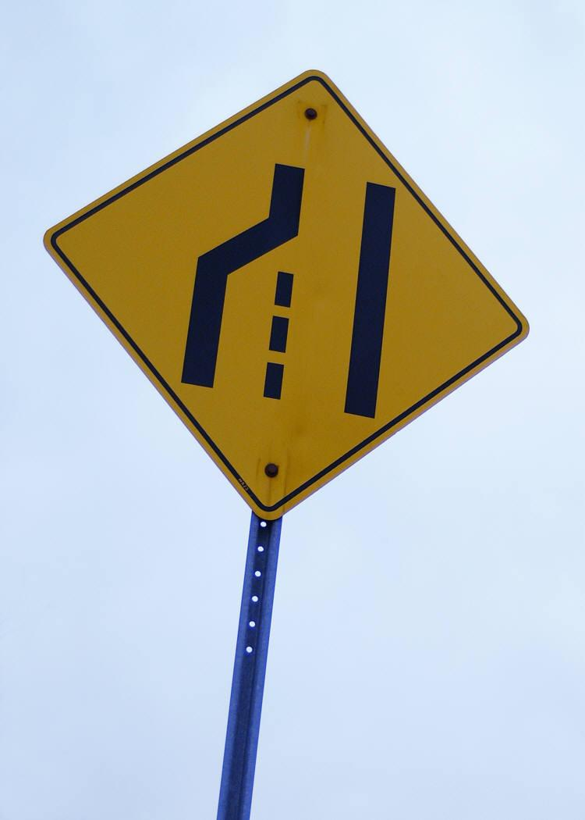
Terms to Know: The Merge
The merge is the act of what Harris calls “coming to terms” with texts – the close reading, the annotation, the identification of the author’s “project.”

Slide 9
Terms to Know: Road Rage
Road rage is the failure to respectfully acknowledge counterarguments (or the failure to conform to the traditional and respectful rules of argumentation).

Slide 10
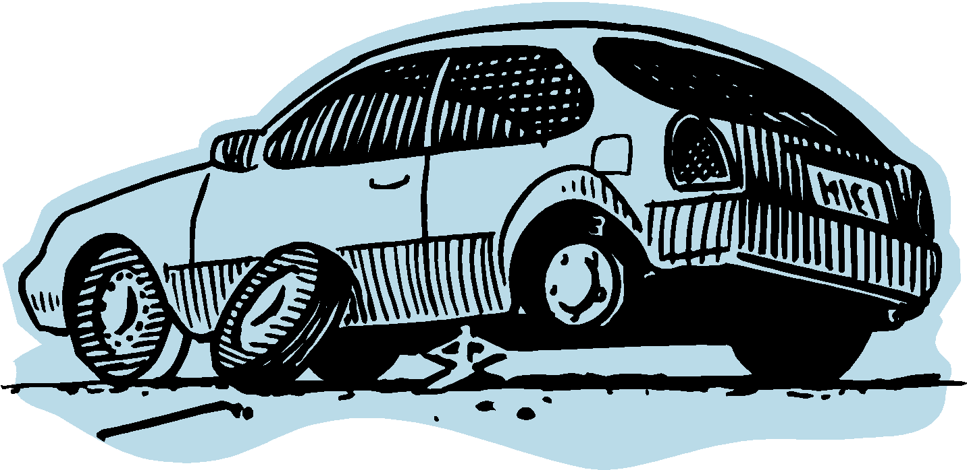
Terms to Know: Flat tire
Avoiding a flat tire is a way to think about students’ mastery of basic writing conventions – skills that give the writer credibility with a wider audience.
Having a flat tire can slow an argument down or even temporarily leave it stranded. The good news is that flat tires can be easily fixed, putting the writer back on the argument highway toward the destination.

Slide 11
The Vehicles (Forwarding Moves)
Extending
Authorizing
Illustrating

Slide 12
The Vehicles (Countering Moves)
“The aim of countering is to open up new lines of inquiry.”
–Harris in Rewriting: How to Do Things with Texts
All forms of Countering
(Arguing the Other Side, Uncovering Values, Dissenting)

Slide 13
Forwarding Moves
Illustrating – When students use specific examples from the text to support what they want to say.
The 18-wheeler carries lots of cargo, representing “material to think about: anecdotes, images, scenarios, data.” (Harris)

Slide 14
What Illustrating Looks Like
Language that captures what an author is saying/doing, as in these templates from Graff and Birkenstein’s They Say I Say:
X argues that
X claims that
X acknowledges that
X emphasizes that
X tells the story of
X reports that
X believes that

Slide 15
Forwarding Moves
Authorizing – When students quote an expert or use the credibility or status of a source to support their claims.

Slide 16
What Authorizing Looks Like
Language that names the particular expertise, credibility, and/or status of an author or source, as in these examples:
Joseph Bauxbaum, a researcher at the Mount Sinai School of Medicine, found …
… , according to Susan Smith, principal of a school which encourages student cell phone use.
A study conducted by the Gulf Coast Center for Law & Policy Center revealed that …

Slide 17
Forwarding Moves
Extending – When students put their own “spin” on terms and ideas they take from other texts.

Slide 18
What Extending Looks Like
Language that reframes the text, adds another layer of interpretation, and/or drives it forward to new conclusions:
So now the latest victims of the Fear of Missing Out are the executives at Facebook themselves, whose dwindling market share is a result of greed and the failure to respond to the demands of a wired generation.

Slide 19
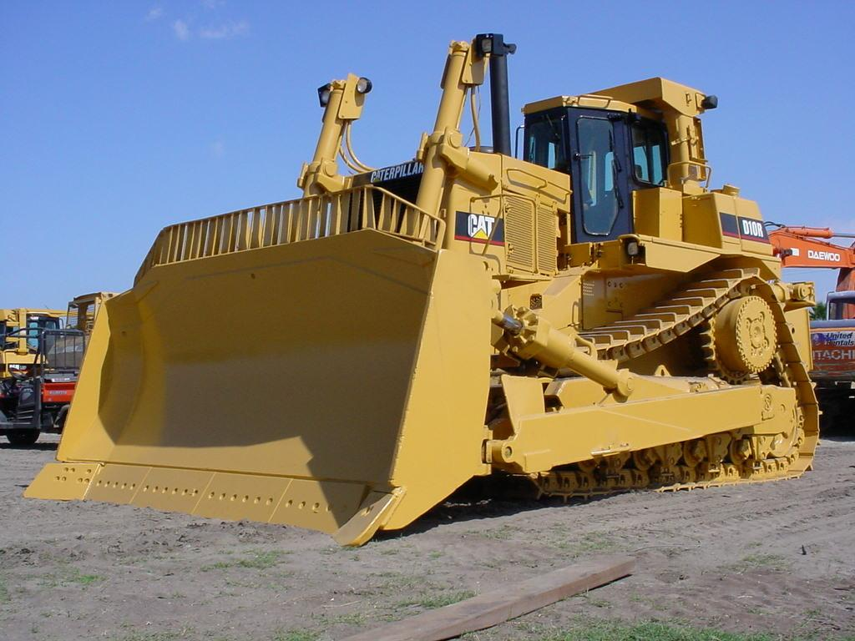
Countering Moves
When students “push back” against the text in some way. They might disagree with it, challenge something it says, or interpret it differently than the author does.

Slide 20
What Countering Looks Like
Language that takes another approach, identifies hidden or absent arguments, or explains where an argument falls short.
What the author fails to consider is … This is true, but …
The same thing can be said for …
The author doesn’t explain why ….
Another way to look at this is …
The study doesn’t explore the connections between …

Slide 21
Works Cited
Harris, Joseph. Rewriting: How to Do Things with Texts. Utah: Utah
State University Press, 2006. Print.
Graff, Gerald and Cathy Birkinstein. They Say I Say: The Moves that
Matter in Academic Writing. 2nd ed. New York: W.W. Norton &
Company, 2009. Print.

Slide 22
Next Steps: Teaching the Moves with a Text Set
1. “Northwestern Players Get Union Vote”
http://espn.go.com/college-football/story/_/id/10677763/northwestern-wildcats-football-players-win-bid-unionize
2. “Of Course Student Athletes are University Employees”
http://www.theatlantic.com/entertainment/archive/2014/04/of-course-student-athletes-are-university-employees/360065/
3. “Northwestern Labor Ruling: Paying College Athletes Should Not Be the Name of the Game” http://www.nydailynews.com/sports/college/bondy-paying-college-players-game-article-1.1736195

Slide 23
Merging
Have students closely read and annotate each text, marking evidence – including and especially those statements:
With which they agree and disagree
That challenge their thinking
That support what they already think
That make them think of new/other ideas

Slide 24
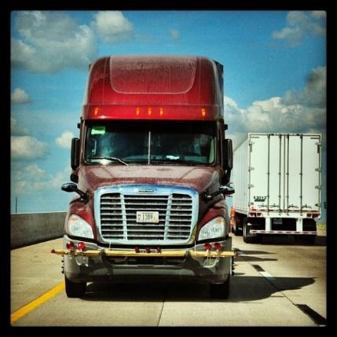
Test drive some vehicles!
Review the purposes of each of the four moves, then have students label their pieces of evidence according to how they might use them in their arguments: to illustrate, authorize, extend, or counter.
Then, using the templates and examples provided, have them practice using and commenting on the source material in various ways.

Slide 25
Questions for Teacher Reflection
How can this metaphor help my students understand academic moves?
How can I provide students with daily practice writing these moves into their arguments?
How will I know that my students are mastering these academic moves?
How will I determine which moves require more instruction?*
*The NWP Using Sources Tool is one resource to help teachers examine the ways students are using sources in their writing.

Slide 26
Extension Ideas & Mini-Lessons
The Argument Highway metaphor lends itself to extensions and mini-lessons that can further help students improve their argument writing. These are introduced on the next few slides.
Red Light/Green Light
Don’t Run Off the Road!
The Cliff of No Support
The Back Road of Non-Credibility

Slide 27
Red Light/Green Light
Use to assess understanding or have students express where they are with claims. In favor of the issue? Green light. Undecided or agree/disagree with exceptions? Yellow light. Completely disagree? Red light.

Slide 28
Don’t run off the road!
Another way of thinking about the “quote sandwich,” teaching students to always explain how source material is relevant to their claims.
Introduce quote
Explain quote

Slide 29
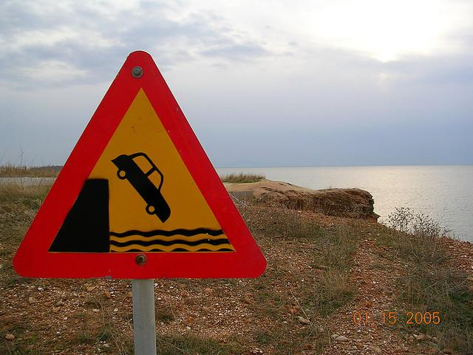
The Cliff of No Support
Encourage students to build their roads of textual support all the way to their argument destinations.

Slide 30
The Back Road of Non-Credibility
This metaphor reminds students to use credible academic sources and to distinguish between the source material and their own writing.

Slide 31
Have an exciting journey on the Argument Highway!

