Slide 1
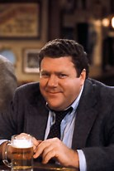
Group “Norms”
What do we want to agree upon in order to work together effectively these 3 days?
What helps you learn best in a PD setting?

