Slide 1
Alternative Structures to the Age-old Five-paragraph essay
Nikki Hunt, Eastern Kentucky University Writing Project
&
Sherry Logan, Bluegrass Writing Project
Notes:
Introduction of self and credibility (Nikki and Sherry)

Slide 2
Session outcomes
Our goal is for you to understand and value the significance of using alternative structures to the five-paragraph essay with students.
To achieve this goal, you will:
experience a brief mini-unit to gather background information about the topic, “Should Cold Sufferers Wear Masks?”
explore alternative structures to the five-paragraph essay
participate in collaborative conversations with colleagues
reflect on how you can use these alternative structures in your classroom
Notes:
Nikki

Slide 3
What is the age-old five-paragraph Essay anyway and why is it doing more harm than good?
The five-paragraph essay follows this structure…
Introduction
3 body paragraphs
Conclusion
What’s wrong with the five-paragraph essay?
Let’s take a look at the article, “If You Teach or Write 5-Paragraph Essays--Stop It!” by Ray Salazar
Notes:
Nikki- share example, “Dreams”…have participants review article and share out at table/whole group (revelations, etc.) Sherry- discuss quote about why we shouldn’t teach 5-paragraph

Slide 4
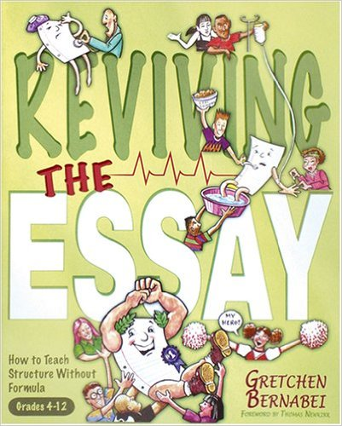
If we don’t teach the five-paragraph essay, what do we teach?
Alternative structures to the five-paragraph essay:
Gretchen Bernabei’s structures for kernel essays (from Reviving the Essay)
Argumentation Planners (more complex): Model of Rogerian Argument,
Model of Toulmin System, and Model of Classic Oration
Photo Credit: https://books.google.com/books/about/Reviving_the_Essay.html?id=38ANAgAACAAJ
Notes:
Nikki- explain what kernel essays are, review Bernabei resource

Slide 5
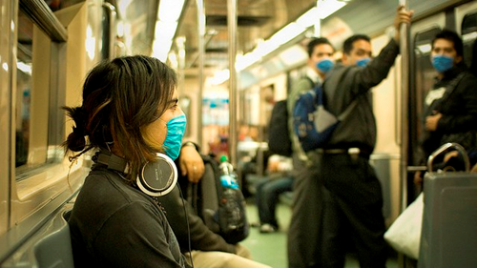
Before we explore, let’s gather background information
Let’s experience the mini-unit, “Should Cold Sufferers Wear Masks?”
Photo Credit: Eneas De Troya
Notes:
Sherry- abbreviated version of PPT…only view/read texts and encourage participants to take notes (t-chart as shown in mini-unit)

Slide 6
Let’s explore a Modeled Bernabei structure
The Story of My Thinking: “First I thought…Then I learned…Now I think”
First I thought cold sufferers should not wear masks, because simply wearing a mask will not protect you from getting sick. Plus, wearing a mask lessens your exposure to diseases that aid in strengthening your immunity.
Then I learned sneezes and coughs can carry diseases and masks can help keep you from getting sick. For example, in the video, “Nothing to Sneeze At”, I learned droplets from a sneeze can be carried farther than I ever thought. Researchers reported that you could be in another room and because the cloud carries droplets, you could still get sick. In addition, promoters of the "Best Sneeze” video suggest grabbing a tissue is most effective in catching a sneeze. A mask would act similarly to a tissue, so a mask would be an effective measure to help keep you from getting sick. Furthermore, the author of the article, “Should Cold Sufferers Wear Medical Masks?, explains that wearing masks are highly effective in preventing disease and are inexpensive.
Now I think cold sufferers should wear masks to help protect themselves and others.
Notes:
Nikki

Slide 7
ANOTHER Bernabei structure with different background information
THROWAWAY WRITING
9-1-1 CALL
Uh….hello, 9-1-1? In this phone call I will tell you about an emergency happening in my house right at this moment. I will tell you the good and the bad things about fires in the living room. First, I will cover the bad things. Smoke is bad. Next, the heat from the flames is also bad. Third, the house will be expensive to replace. This concludes my 9-1-1 phone call.
Student Paper
This is the introduction of my paper. In my paper I am going to tell you about three reasons I think fires are bad. First, I am going to tell you that smoke is bad. Second, I am going to tell you that the flames is also bad. Third, I am going to tell you that the house will be expensive to replace. This concludes my paper.
Question:
Is throwaway writing a necessary first step in getting thoughts on paper?
Notes:
Sherry

Slide 8
Your turn to Explore Bernabei Structures
With your partner:
Discuss your assigned structure
Complete each sentence stem for your assigned structure using background information from, “Should Cold Sufferers Wear Masks?”
With the group:
Share lightbulb moments/instructional implications
Notes:
Nikki and Sherry (we will divide participants and assign them a structure from Bernabei)

Slide 9
Let’s Explore more complex structures
Model of Rogerian Argument
Model of Toulmin System
Model of Classic Oration
With your partner:
Choose a complex structure (from above)
Complete the argumentation planner
With the group:
Share lightbulb moments/instructional implications
Notes:
Nikki and Sherry…introduce planners and assign participants a planner to experience

Slide 10
Reflect and debrief
Turn and Talk (neighbors)…Share Out (whole group)
How will you use what you’ve learned today in your classroom?
What excites you most about today’s learning?
What questions/concerns do you have?
Photo credit:
http://4.bp.blogspot.com/-axneddBpqf0/U5X7T--bSaI/AAAAAAAAIQQ/D6E-xVzc1Y0/s1600/thinking-emoticon.png
Notes:
Nikki and Sherry

